Slide 1

HEALTH CARE CHATBOT SYSTEM
TEAM MEMBERS:
JITENDRA SHRESTHA
PRANISH ACHARYA

Slide 2
INTRODUCTION
Service that provides to the user/client through interpreting natural language
Serves as healthcare assistant
Provides quick responses to common medical symptoms
Seamless User Experience

Slide 3
OBJECTIVES
To provide response on health queries
To diagnose disease based on symptoms provided based on yes/no statement
To provide way to maintain patient health record

Slide 4
FEATURES
Can predict disease based on symptoms provided
User can book appointment
User can view health records
Doctors can provide prescription to booked appointment
Admin can manage doctors

Slide 5
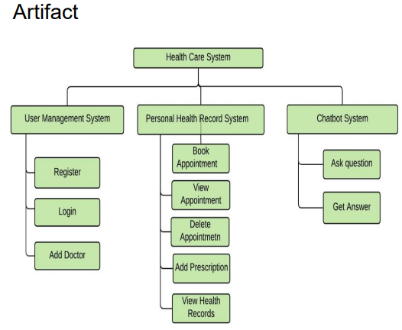
SYSTEM ARCHITECTURE

Slide 6
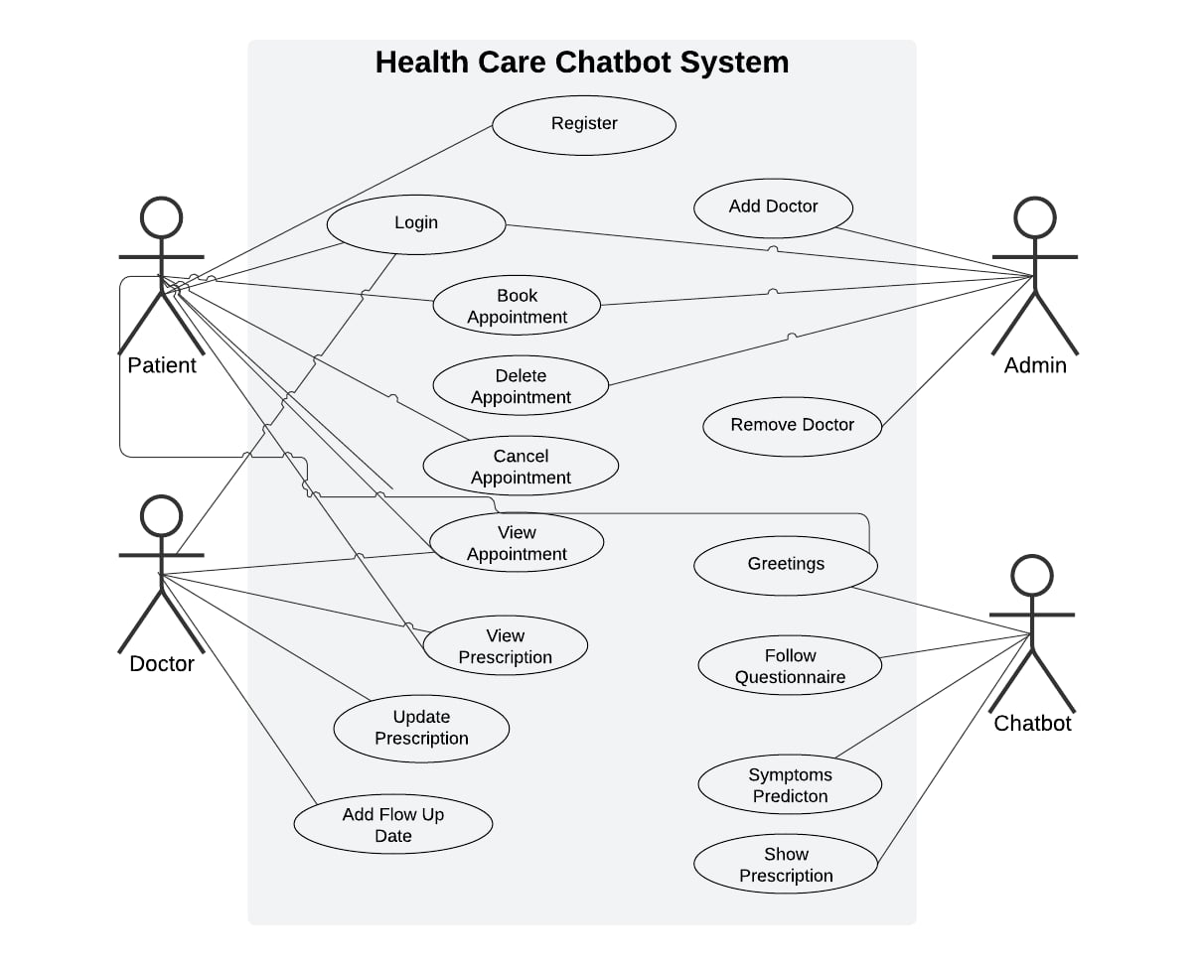
Overall Use Case Diagram

Slide 7
IMPLEMENTATION PLAN
System Planning & Design
Dataset Collection, Design
Integration with Backend, Frontend, and chatroom integration with Django
Testing & Debugging
Delivery & Feedback Collection

Slide 8
TOOLS & TECHNOLOGIES
Frontend: Django , HTML, CSS, JavaScript
Backend: Django, RASA for Chatbot Logic
Database: SQLite
Project Management: Trello(Trial Version)
Work Breakdown Structure: MindView(Trial Version)
balsamiq : For wireframes

Slide 9
USED TOOLS JUSTIFICATION
RASA: Open source tool which can be used for short messages using LSTM
Supports Integration with Django
Community and EcoSystem
Django: Based on Python and Security
Trello: Used for project management to keep track of assigned tasks
Balsamiq: For creating wireframes

Slide 10
ALTERNATIVE TOOLS
Chatbot Logic : Google Dialogflow, chatterbot
Frontend: React based on JavaScript
Backend: Node
Database: MongoDB
Project Management: Asana

Slide 11
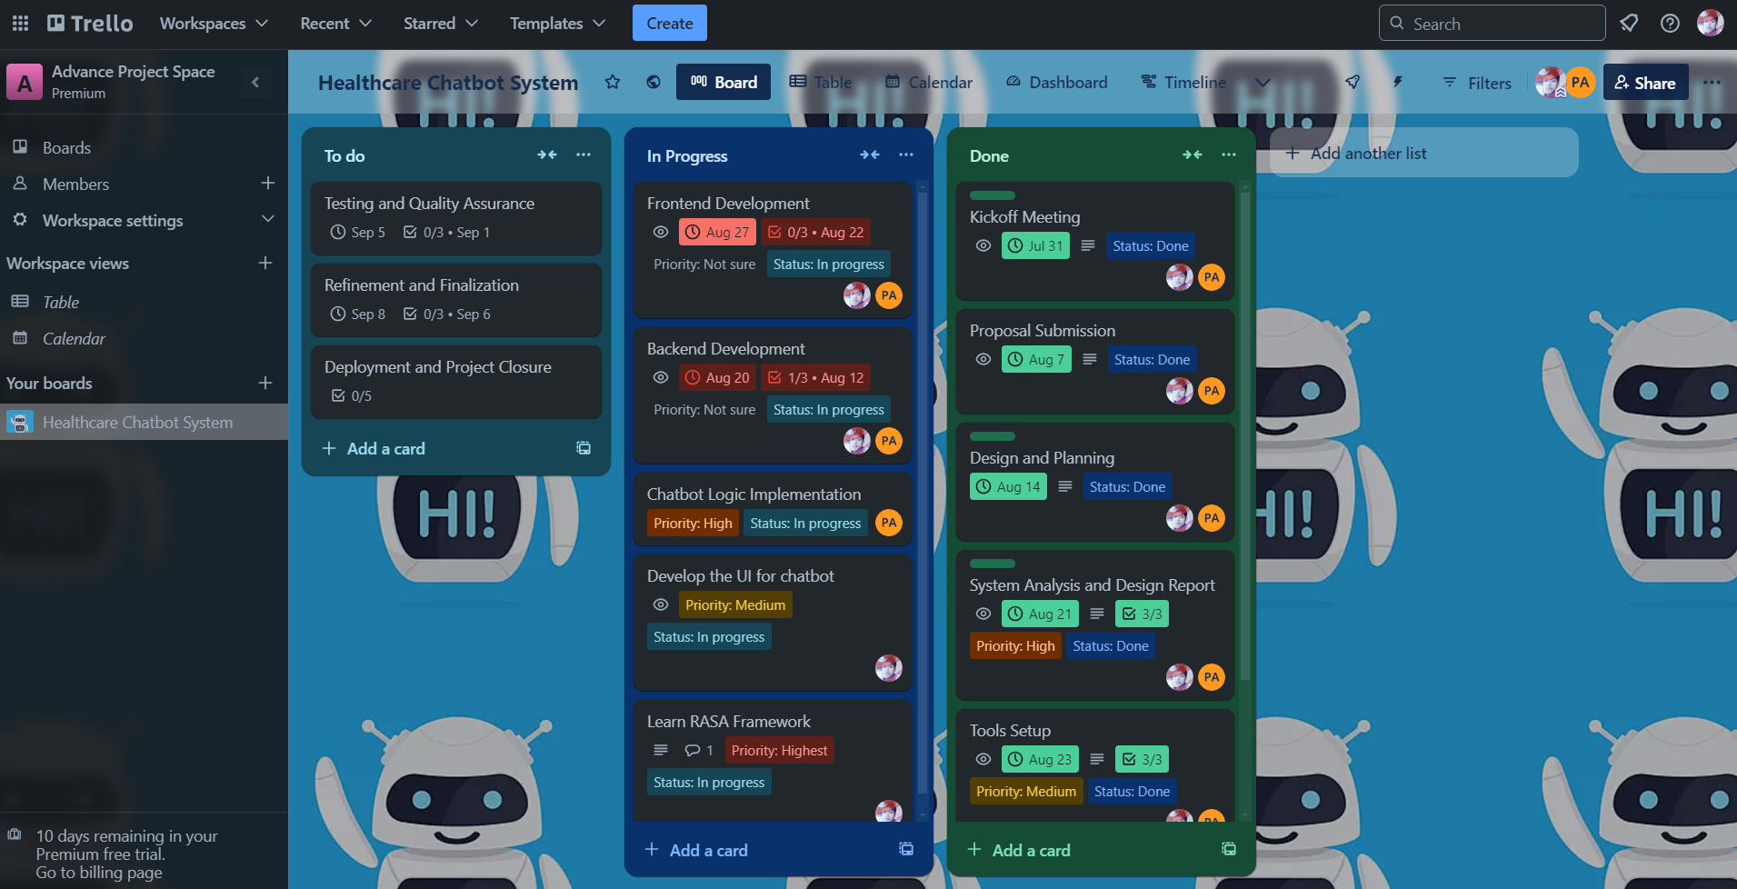
PROJECT MANAGEMENT

Slide 12
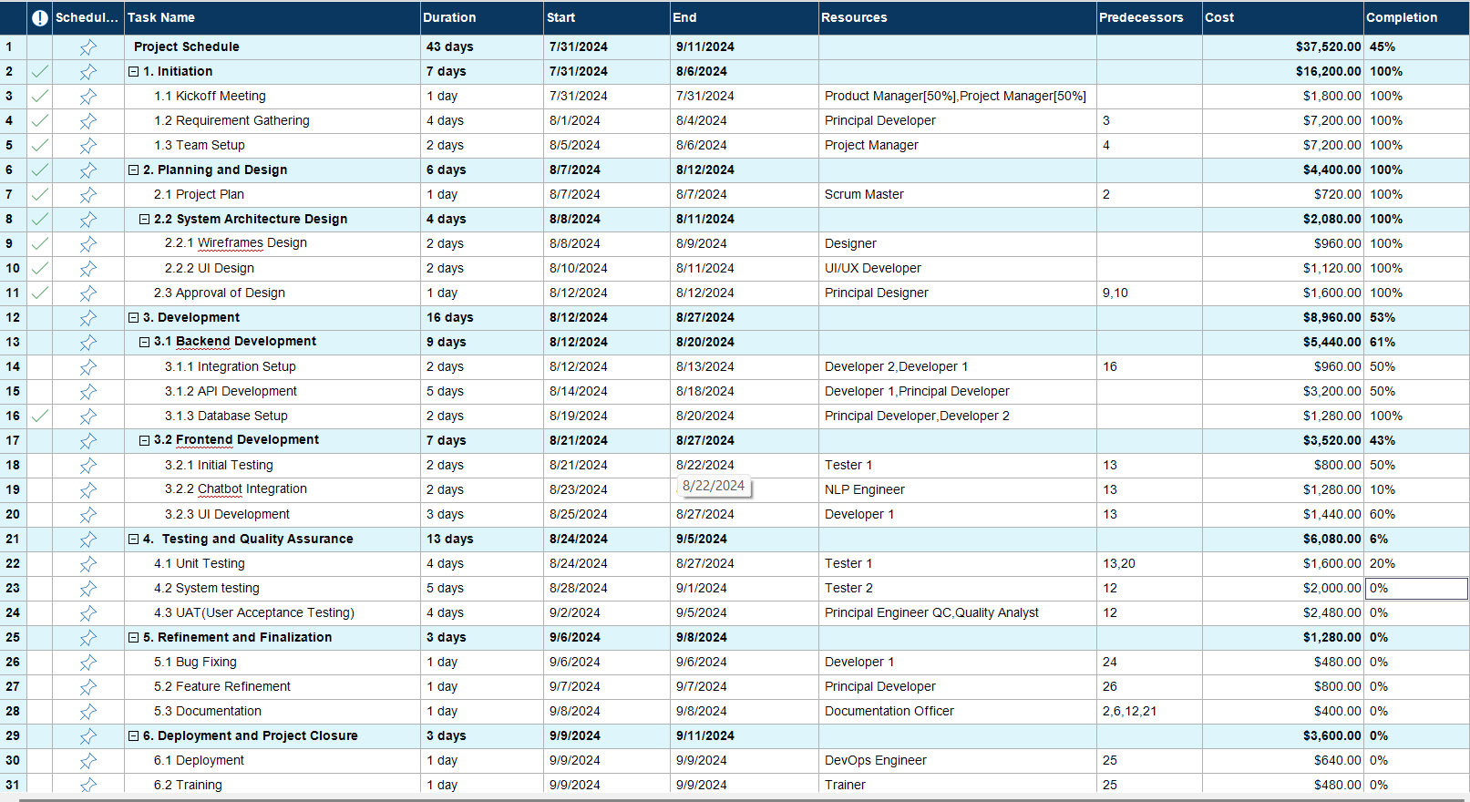
Project Schedule

Slide 13
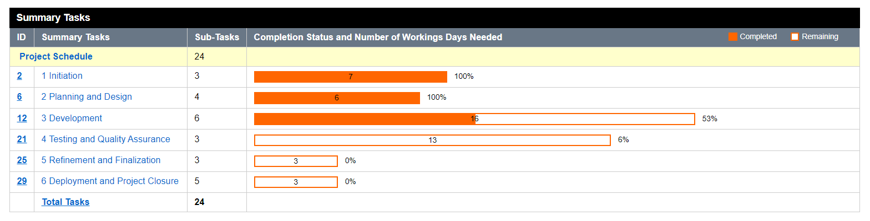
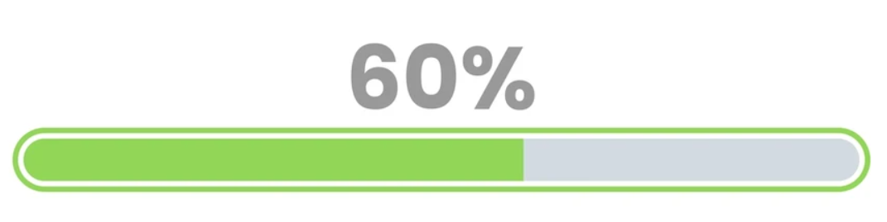
PROJECT PROGRESS

Slide 14
REASON FOR BEHIND THE SCHEDULE
First week was confused on choosing topic between team members
Time Spent on Learning RASA Framework than expected

Slide 15
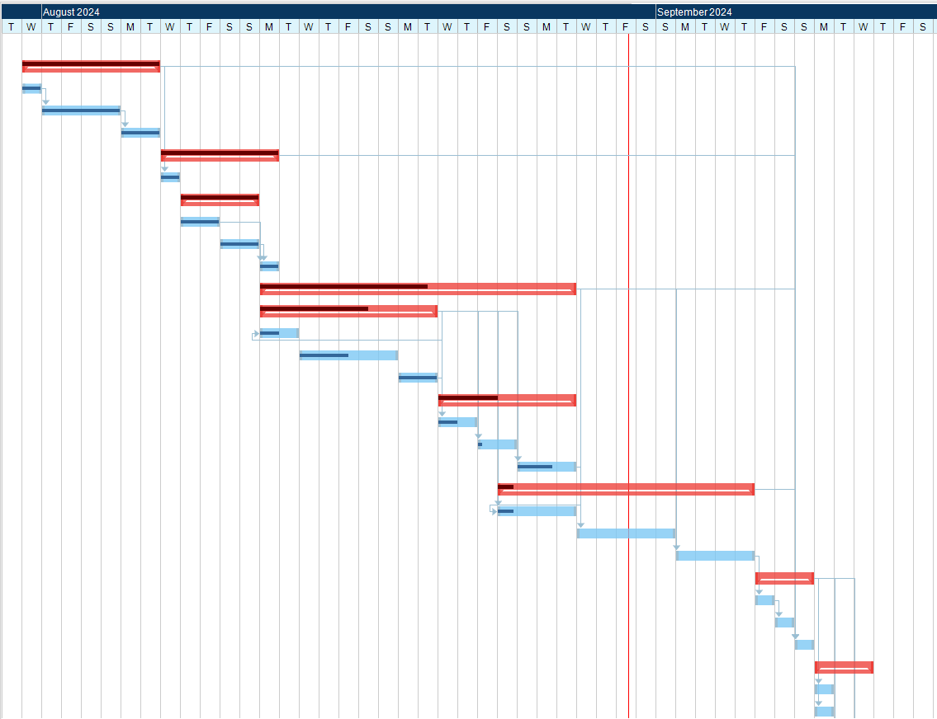
PROJECT TIMELINE

Slide 16
TEAM CONTRIBUTION
Team Member | Contribution
Jitendra Shrestha | Data Classification & Database Management UI Design and Development API Development for chatbot Frontend Integration
Pranish Acharya | Chatbot Logic Implementation using NLP Train Chatbot Dialogue Management Integration with Django

Slide 17
Some Screenshots of System

Slide 18
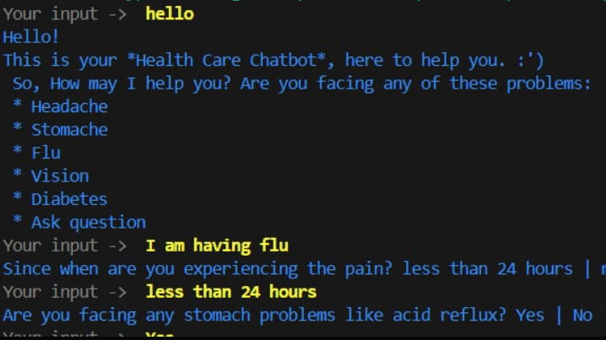

Slide 19
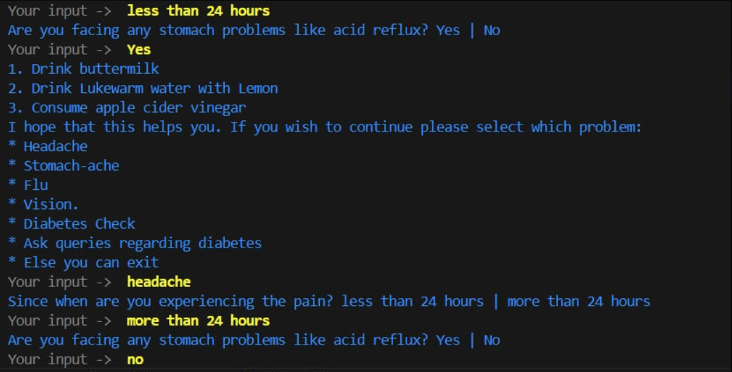

Slide 20
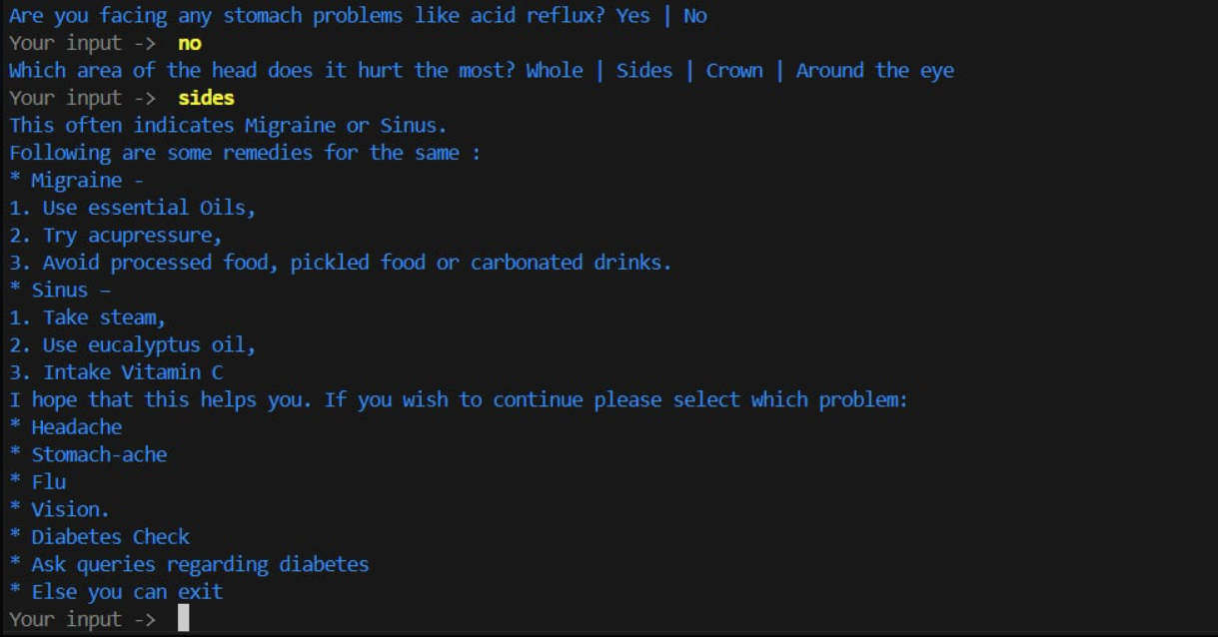

Slide 21


Slide 22
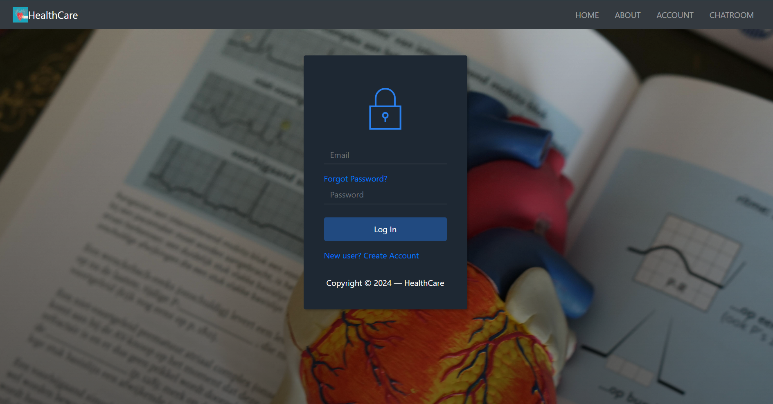

Slide 23


